Slide 1
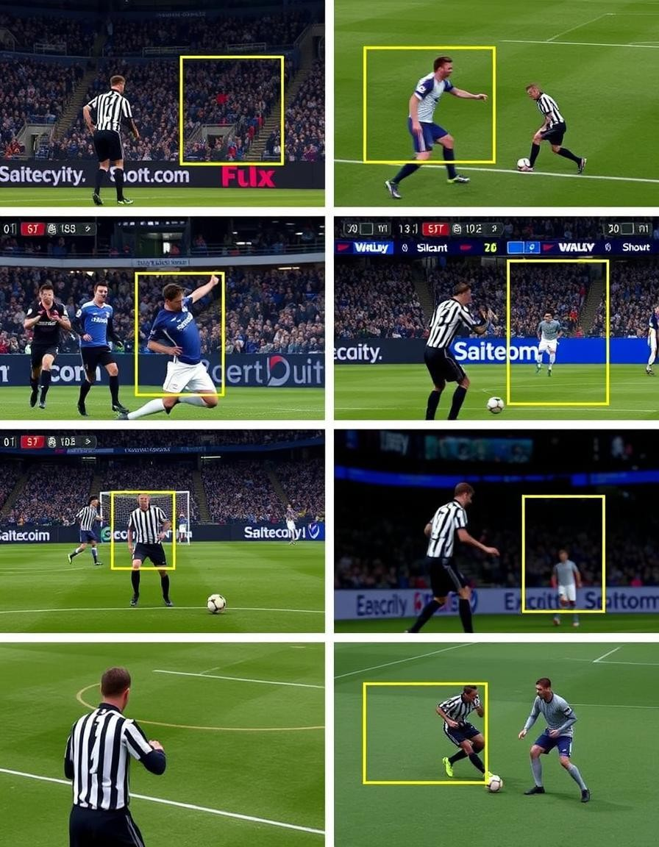
Automated Football Action Detection
This presentation explores automated detection in football. We use deep learning and computer vision techniques. This provides faster, more accurate results.
Raghav Singhal (E23CSEU1278) - Project Lead, Evaluation, Data Collection
Mayank Maletha (E23CSEU1290) - Model Development, Preprocessing, Results Analysis

Slide 2
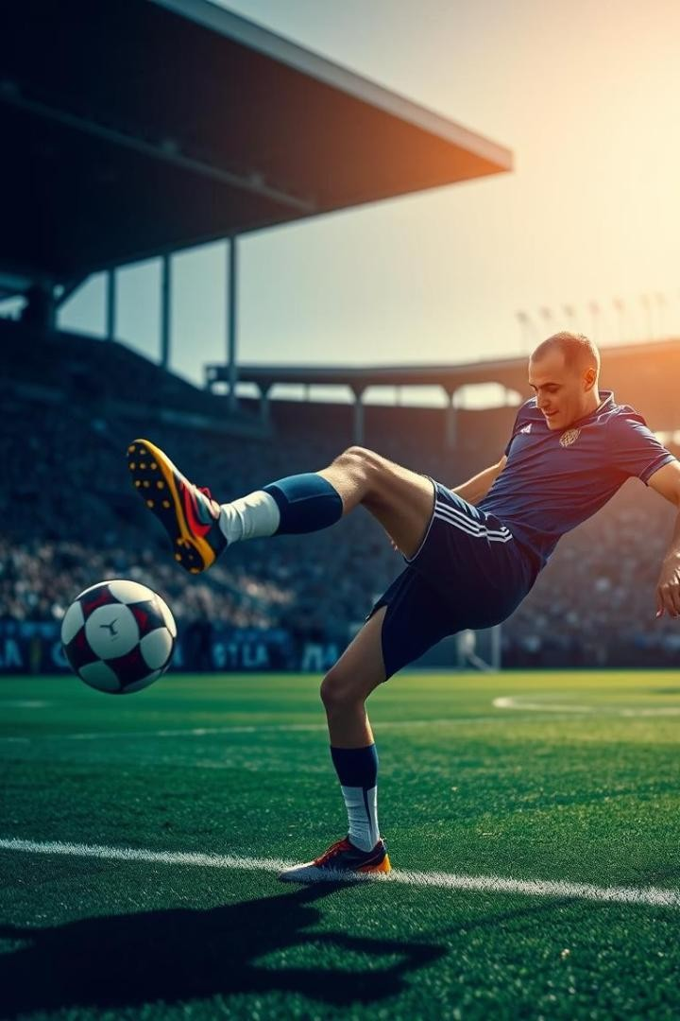
Motivation: Automating Football Analysis
Need for Automation
Football analysis benefits greatly from automation. Manual tracking is slow and prone to errors.
Deep Learning Advantage
Deep learning offers faster, more accurate detection. This enhances real-time capabilities.
Real-World Applications
Referee assistance
Player performance evaluation
Tactical video analysis

Slide 3
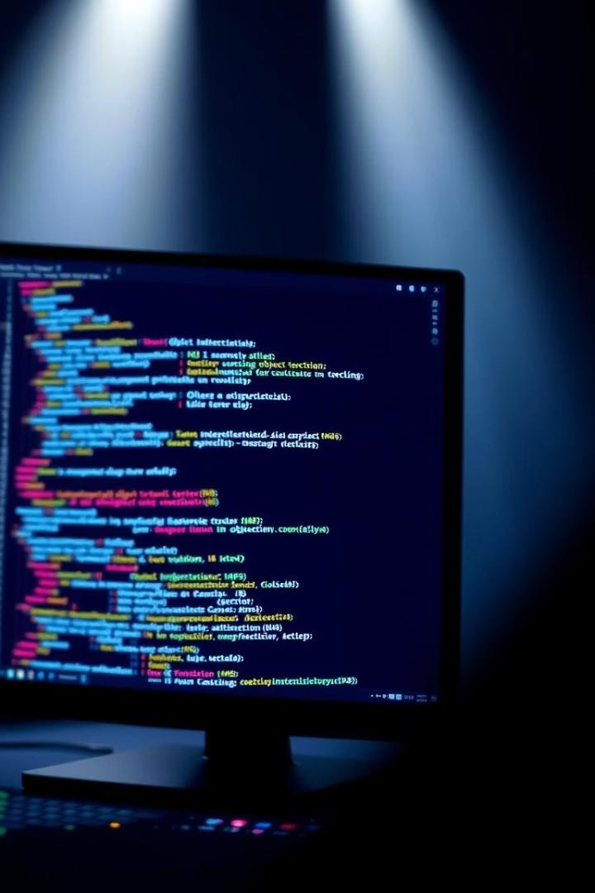



Literature Review: Advancements in Detection
Traditional Methods
Manual labeling and image processing were common. These
methods lacked efficiency.
Deep Learning Evolution
CNNs and YOLO models revolutionized detection. Performance and speed improved significantly.
Related Work
YOLO has been applied in other sports like basketball. Our focus is expanding this to football.

Slide 4
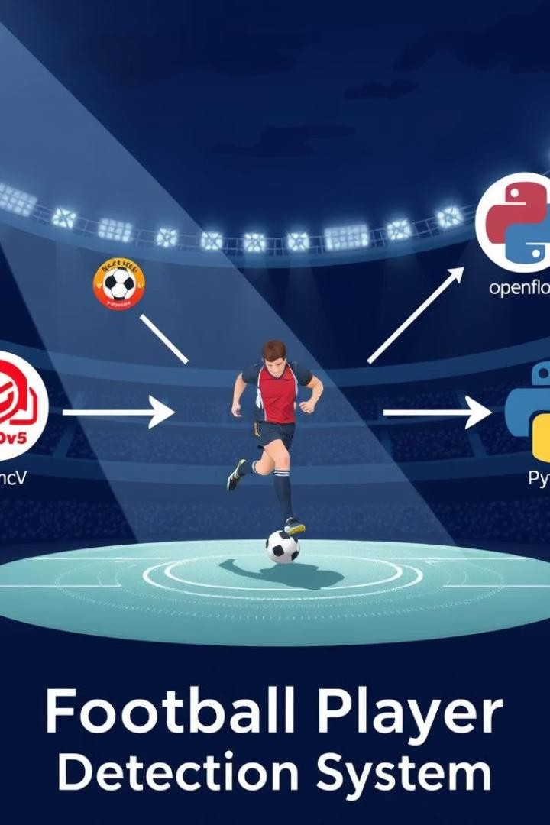

Methodology Formulation: Our Approach
Technologies Used
YOLOv5, OpenCV, Roboflow, and Python form the base.
Pipeline
Dataset collection and preprocessing via Roboflow
Dataset Link : https://universe.roboflow.com/roboflow-
jvuqo/football-players-detection-3zvbc/dataset/1
Training using YOLO (object detection)
Post-processing and visualization using OpenCV
Tools
Python, PyTorch, Google Colab/Jupyter Notebook enabled rapid development.

Slide 5
Results: Dataset Composition
Image Distribution
Total images: 663
Training set: 612 images (92%)
Validation set: 38 images (6%)
Test set: 13 images (2%)
Class Overview
Classes: 4 (Player, Referee, Ball, Goalkeeper)
Annotation: YOLO bounding box format

Slide 6

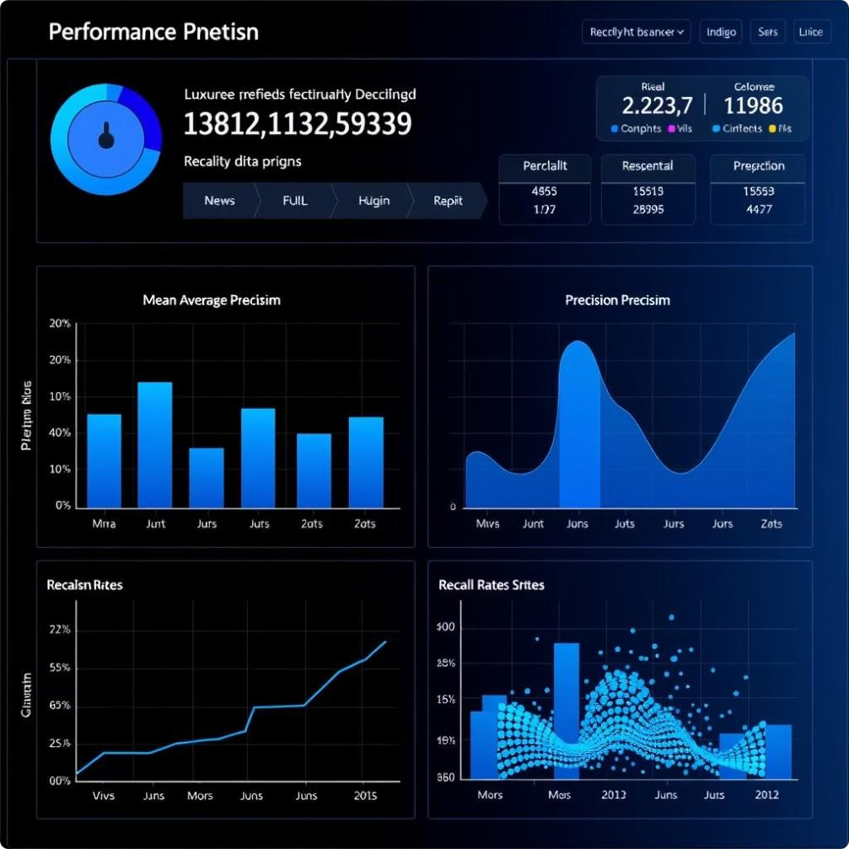
Results: Performance Metrics
78.9%
mAP@50
Mean Average Precision indicates strong overall performance.
86.7%
Precision
High precision shows accurate positive detections.
74.2%
Recall
Recall rate indicates ability to find most relevant objects.

Slide 7
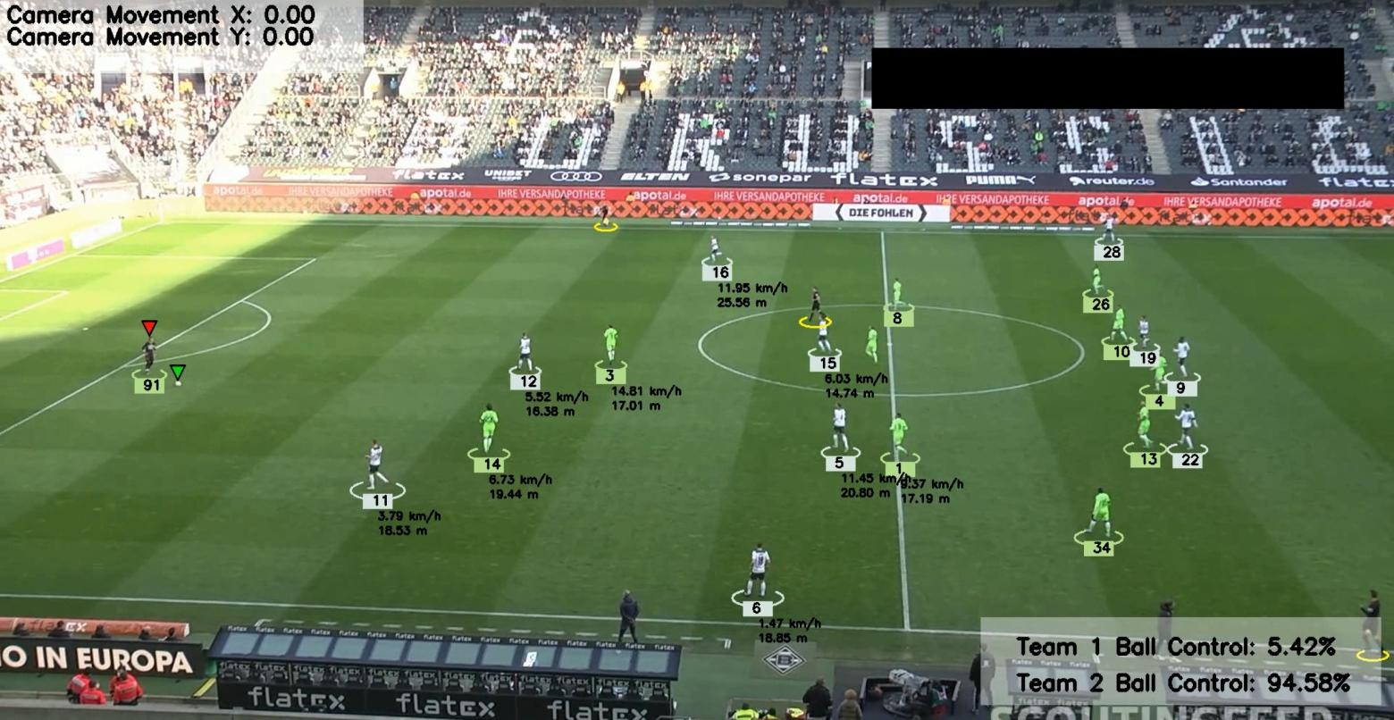
Visual Results: Example Detections
Successful Cases
Model accurately detects players, referees, and ball. This shows strong capabilities.
Qualitative Performance
The football analysis model demonstrates strong qualitative performance across various tasks, highlighting its practical utility and intelligent behavior beyond just numbers.

Slide 8




Future Work: Enhancements and Applications
Potential Directions
Expanding the model to provide live predictions and commentary during ongoing matches could increase its usefulness for broadcasters, coaches, and fans. This includes forecasting momentum shifts, potential goals, or tactical adjustments in real time.
Methodology Improvements
Introducing more granular features such as pass types, pressing intensity, and player heatmaps can provide deeper context and enable richer, more accurate analysis.
1
2
New Applications
Address Limitations
Integrate the model into second-screen experiences, offering real-time tactical insights, player heatmaps, and strategy breakdowns as matches unfold—ideal for broadcasters and engaged fans.
The model’s accuracy and depth of analysis are heavily influenced by the quality and granularity of input data. Inconsistent or incomplete match statistics can lead to biased or shallow interpretations.
4
3

Slide 9
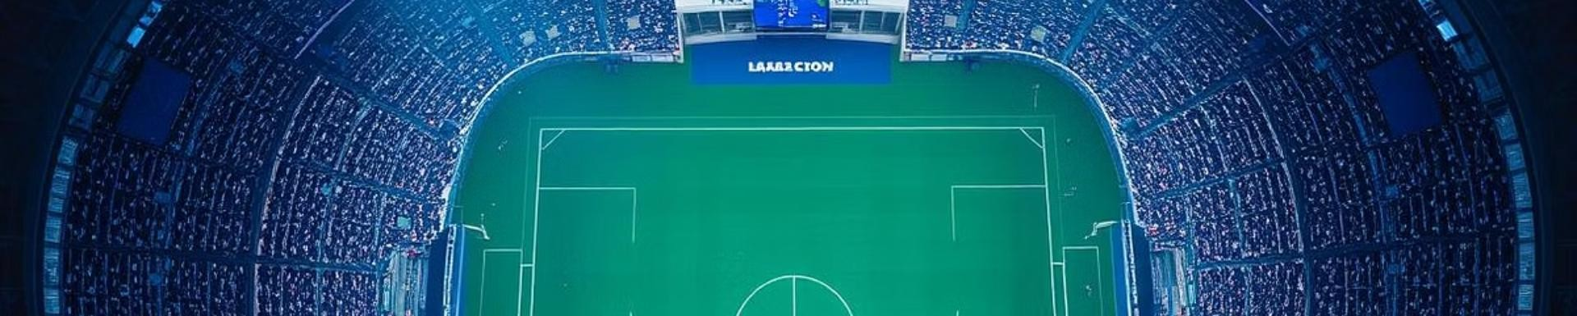
Conclusion: Key Contributions and Impact
Impact
The football analysis model delivers substantial
Significance
Key Findings
impact across the football ecosystem,
The development of this football analysis model marks transforming how data is interpreted, insights
The model performs well across matches from various leagues, showing strong potential for scalability and adaptation to different footballing contexts and styles.
a significant advancement in the intersection of artificial intelligence and sports analytics. Its ability to interpret, summarize, and evaluate complex in-game scenarios mirrors the depth of human expertise, while offering unmatched scalability and speed.
are generated, and decisions are made

Slide 10
Thank You

